Slide 1

Dual-Side Polished SPR Biosensor with Wide Sensing Range
Paper ID
905
Tanvir Alam Roni, Rifat Hassan, Mohammad Faisal
Department of Electrical and Electronic Engineering
Bangladesh University of Engineering and Technology (BUET)

Slide 2

Abstract
Sensor: Two tightly coupled CSRRs loaded on a patch
Resonant Frequency: 5 GHz
Sensing Parameter: Shift in resonance frequency
Sensitivity: 1 ${MHz/mgmL}^{−1}$
Sensing Range: 3-7 mg/mL

Slide 3
Introduction
Diabetes Mellitus: A major health issue
Current Standard Detection Techniques: Invasive
Non-invasive approach:
Freely Accessible Body Fluids: sweat, tears, saliva, urine
2) Breath Analysis
3) Spectroscopic Methods:
Impedance Spectroscopy
Optical Resonator based Sensor
RF / Microwave based Sensor

Slide 4
Introduction
RF / Microwave based Sensing Technique
1) Change in permittivity with glucose level
2) Dependency of frequency response with dielectric properties of surrounding material

Slide 5
Introduction
Recent Literature Review
1) Microstrip Resonator
2) Stepped Impedance Resonator
3) LC Passive Resonator
4) Metamaterial Unit Cell
i) Split Ring Resonator (SRR)
ii) Complementary Split Ring Resonator (CSRR)

Slide 6
Introduction
Sensor of the Presented Work
Based on CSRR
Senses change in glucose level through change in resonant frequency
Comparatively Higher Sensitivity
Simply Configuration thus reducing the cost

Slide 7
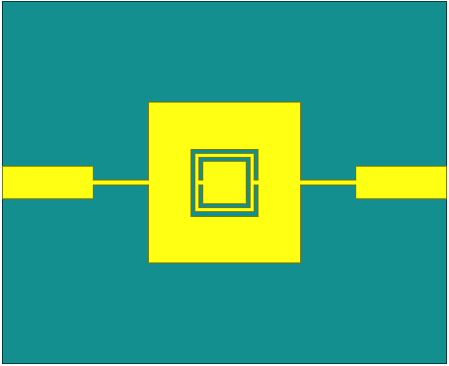
Sensor Design
CSRR-loaded rectangular patch
- fed by quarter wave transformer and microstrip line
Two square shaped CSRRs
Designed on a Rogers RT/Duroid 5870 substrate

Slide 8
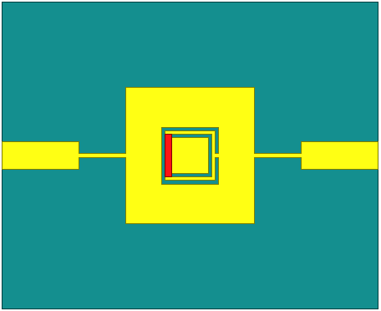
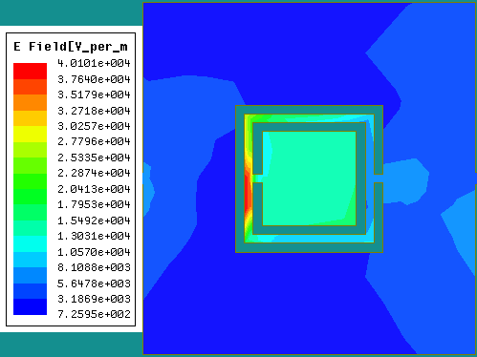
Glucose Solution
Realized by placing a rectangular box (red) just top on the most sensitive region of the resonator
To vary the concentration of glucose solution, the dielectric properties of the materials assigned to the box were changed accordingly

Slide 9
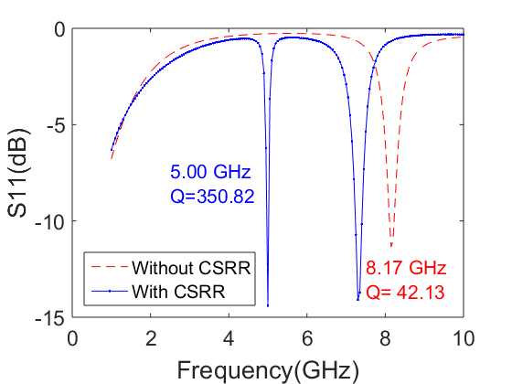
Analysis of the Sensor
Resonant frequency mainly depends on the CSRRs
Both resonant frequency and Q factor changes with the loading of the CSRRs

Slide 10
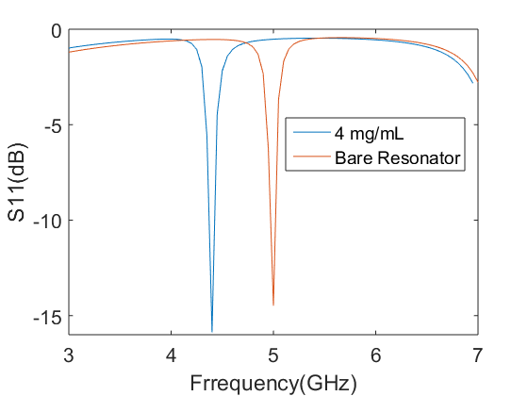
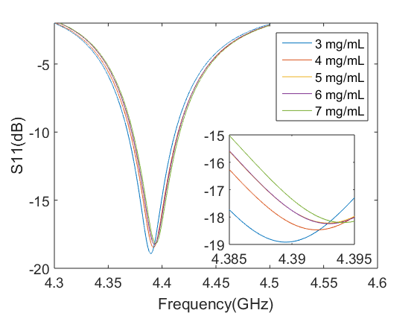
Results
Resonant Frequency (Bare): 5 GHz
Glucose Dependent shift in resonant frequency
For Glucose solution shifted to 4.39 GHz

Slide 11
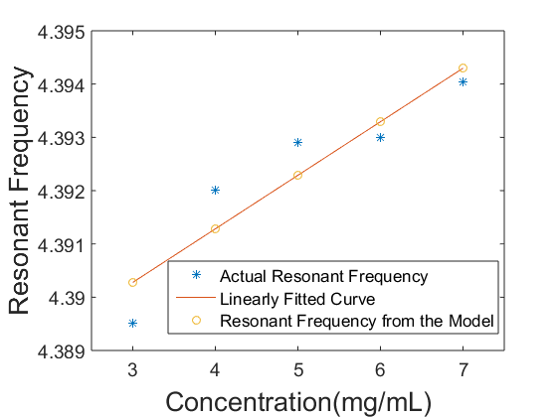
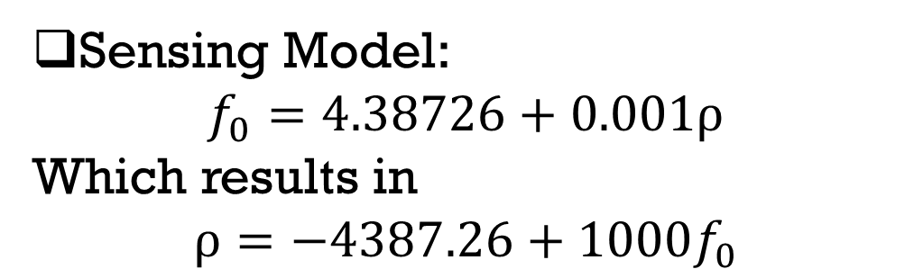
Results
Sensing Model:
$$f_{0}=4.38726+0.001ρ$$
Which results in
$$ρ=−4387.26+1000f_{0}$$
In glucose detection, up to 20% error is acceptable

Slide 12
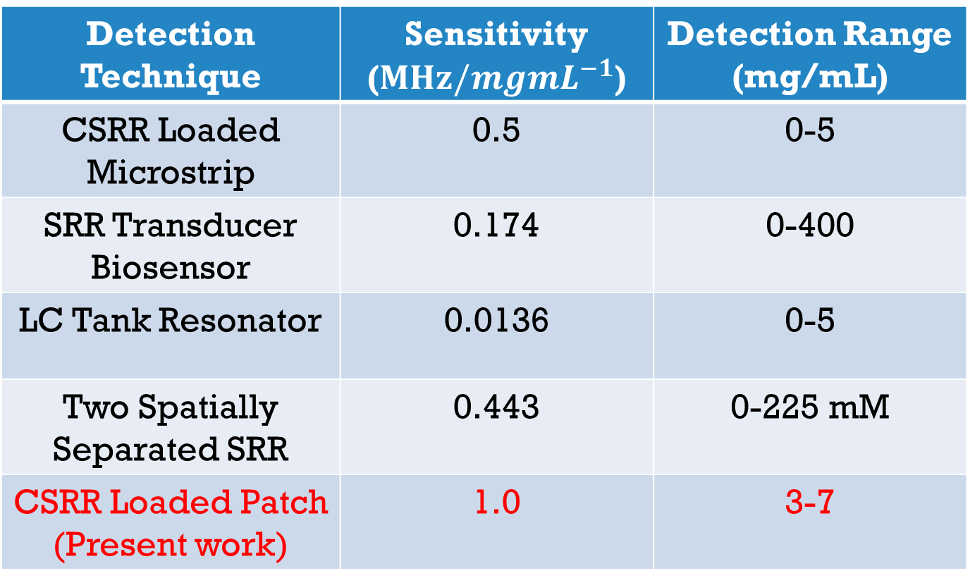
Comparison
Detection Technique | Sensitivity ($MHz/{mgmL}^{−1}$) | Detection Range (mg/mL)
CSRR Loaded Microstrip | 0.5 | 0-5
SRR Transducer Biosensor | 0.174 | 0-400
LC Tank Resonator | 0.0136 | 0-5
Two Spatially Separated SRR | 0.443 | 0-225 mM
CSRR Loaded Patch (Present work) | 1.0 | 3-7

Slide 13
Limitations
No fluidic channel was considered
Thickness of the resonator was ignored
Variation in dielectric properties due to frequency was not considered

Slide 14

Conclusion
CSRR based biosensor to detect glucose level
Development of a mathematical model
Sensitivity: 1 $MHz/{mgmL}^{−1}$
Detection range: 3 – 7 mg/mL
Simple Structure

